Slide 1
Review : Progressive Layered Extraction(PLE)
A Novel Multi-Task Learning (MTL) Model for Personalized Recommendations
Kaist GSDS Master’s Degree
20224314
Hyeongu Kang
Notes:
안녕하세요 오늘 Progressive Layered Extraction 논문 Review를 맡은 GSDS 강현구입니다.
Hello, I’m Hyun-gu Kang of GSDS, in charge of the Progressive Layered Extraction paper review today.

Slide 2
CONTENTS
1. Summary of Paper
2. Pros & Cons
3. Research Idea
Define problem
Related work / prior method
Solving method
Experiment
Result
Strong point
Weak point
Notes:
발표 순서는 다음과 같이
Summary of Paper
Pros & Cons of Paper
Research Idea
로 구성하였습니다.
The order of presentation is as follows
1. Summary of Paper
2. Pros & Cons of Paper
3. Research Idea

Slide 3
1. Summary of Paper
Define Problem
Related work / prior method
Solving Method
Experiment
Result
Notes:
Summary of paper에서는 다음과 같이 5단계에 맞춰 설명 드리겠습니다.
In the ‘Summary of Paper’, I will briefing paper in five steps as follows.

Slide 4
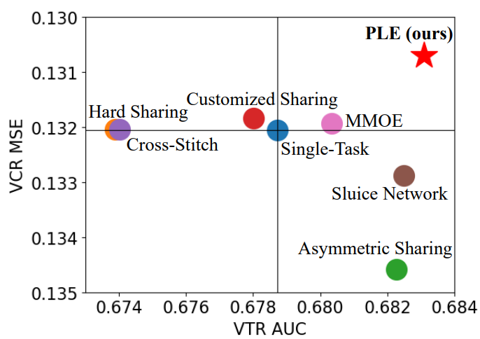
Define Problem
1. Summary
1) Negative Transfer
<Customized Gate Control(CGC) Model>
Common phenomenon in MTL for loosely correlated tasks
- Performance deterioration in MTL
2) Seesaw Phenomenon
Occur when tasks are 1) strongly correlated, 2) sample dependent
Improvement of one task leads to
performance deterioration of other tasks
Negative Transfer and Seesaw Phenomenon are
common problem of MTL. Solving both is important.
Notes:
이 논문에서는 Multi task learning 문제에서 자주 발생하는 Negative Transfer과 Seesaw Phenomenon 2가지로 정의하고 있습니다.
이때 Negative Transfer은 각 Task 간의 상관관계가 낮거나, 오히려 충돌하는 경우에 성능이 악화되는 것을 의미합니다.
이후에 자세히 다루겠지만 Negative Transfer을 해결하려는 방법들은 여럿 제시되어 왔습니다.
반면 Seesaw Phenomenon은 이번 Paper에서 처음으로 정의한 것으로,
Task 간의 상관관계가 높고, 연관성이 높을 때
특정 task의 성능 향상이 연관된 다른 Task의 성능을 악화시키는 현상을 의미합니다.
옆에 첨부한 Figure와 같이 대부분의 방법론들이 seesaw Phenomenon을 가지고 있음을 확인할 수 있습니다.
다시 돌아와서 Negative Transfer과 Seesaw Phenomenon은 MTL에 있어 흔히 일어나는 문제들로, 해결하는 것이 중요합니다.
In this paper, we define two problems: Negative Transfer and Seesaw Phenomenon, which occur frequently in multi-task learning problems.
Negative Transfer means that the performance will deteriorate if the correlation between each task is low, or rather if there is a conflict.
There are several ways to resolve Negative Transfer.
I'll explain the details later.
Seesaw Phenomenon, on the other hand, is defined first in this paper
This Phenomenon happens when the correlation between tasks is high and dependent each other
It means that a performance improvement in a particular task lead to the performance of the other tasks is deteriorating.
You can see that most methodologies have a seesaw phenomenon, as shown in the figure attached next to them.
Since Negative Transfer and Seesaw Phenomenon are common problems with MTL, and it's important to solve them.

Slide 5
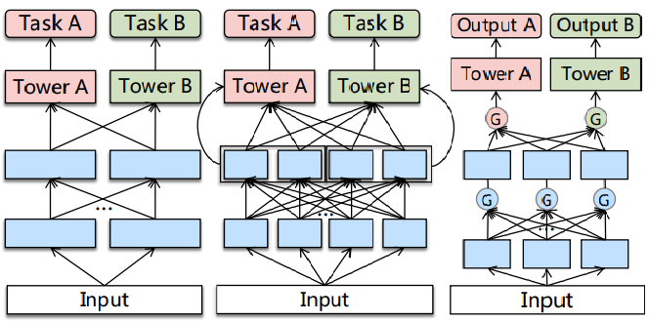
Related word / Prior method
1. Summary
<Cross-Stitch Network>
<Sluice Network>
<ML-MMOE>
Several methods of prior work of MTL
try to solve negative transfer, but neglect the seesaw Phenomenon
Notes:
지금까지 Negative Transfer을 해결하기 위해 Cross-stitch network, Sluice network, MMOE 등의 방법론을 고안해왔습니다.
하나의 예시로 MMOE는 Gate Network를 통해서 각 Task 간의 차이점을 구별했고, 그 결과 SOTA 결과를 만들어 냈습니다.
하지만 각 Task 간의 상관관계를 찾아내지 못했기 때문에 성능 향상에 제약이 있었습니다.
그 외에도 지금까지의 방법론들은 Negative transfer은 해결하고자 했으나, Seesaw Phenomenon에 대해선 고려하지 않았습니다.
따라서 Task 가 시행되는 Expert 사이에서 차이와 관계 둘 다 고려할 줄 아는 모델을 디자인하는 것이 필요했습니다.
So far, many methodologies are devised such as Cross-stitch network, Slice network, and MMOE to solve Negative Transfer.
As an example, MMOE distinguished the differences between each task through the Gate Network, resulting in SOTA results.
However, there was a limit to performance improvement because no correlation was found between each task.
Other methodologies have tried to solve Negative transfer, but have not considered Seesaw Phenomenon.
Therefore, it was necessary to design a model that could take into account both differences and relationships between the Expert

Slide 6
Related word / Prior method
1. Summary
<Cross-Stitch Network>
<Sluice Network>
<ML-MMOE>
<Property>
Learn weights of linear combinations to fuse representations from different tasks
→ Try to deal tasks conflict
But, representations are combined with the same static weights for all samples
→ Can’t address Seesaw Phenomenon
* Adaptive combinations of tasks is needed
By reviewing Cross-Stitch Network and Sluice Network,
we can check that adaptive combinations of tasks is needed
Notes:
지금까지 Negative Transfer을 해결하기 위해 Cross-stitch network, Sluice network, MMOE 등의 방법론을 고안해왔습니다.
하나의 예시로 MMOE는 Gate Network를 통해서 각 Task 간의 차이점을 구별했고, 그 결과 SOTA 결과를 만들어 냈습니다.
하지만 각 Task 간의 상관관계를 찾아내지 못했기 때문에 성능 향상에 제약이 있었습니다.
그 외에도 지금까지의 방법론들은 Negative transfer은 해결하고자 했으나, Seesaw Phenomenon에 대해선 고려하지 않았습니다.
따라서 Task 가 시행되는 Expert 사이에서 차이와 관계 둘 다 고려할 줄 아는 모델을 디자인하는 것이 필요했습니다.
So far, many methodologies are devised such as Cross-stitch network, Slice network, and MMOE to solve Negative Transfer.
As an example, MMOE distinguished the differences between each task through the Gate Network, resulting in SOTA results.
However, there was a limit to performance improvement because no correlation was found between each task.
Other methodologies have tried to solve Negative transfer, but have not considered Seesaw Phenomenon.
Therefore, it was necessary to design a model that could take into account both differences and relationships between the Expert

Slide 7
Related word / Prior method
1. Summary
<Cross-Stitch Network>
<Sluice Network>
<ML-MMOE>
<Property>
- Apply gate networks to obtain different fuse
weight of task difference among bottom expert
→ 1) Deal with negative transfer
and 2) optimize multiple objectives
- But MMOE not consider task correlation
→ Limit the performance of joint optimization
* There is no Task-specific / Task-shared concept
By reviewing ML-MMOE Model, Gate network is effective to fuse different tasks but we also consider task specific / shared concept
Notes:
지금까지 Negative Transfer을 해결하기 위해 Cross-stitch network, Sluice network, MMOE 등의 방법론을 고안해왔습니다.
하나의 예시로 MMOE는 Gate Network를 통해서 각 Task 간의 차이점을 구별했고, 그 결과 SOTA 결과를 만들어 냈습니다.
하지만 각 Task 간의 상관관계를 찾아내지 못했기 때문에 성능 향상에 제약이 있었습니다.
그 외에도 지금까지의 방법론들은 Negative transfer은 해결하고자 했으나, Seesaw Phenomenon에 대해선 고려하지 않았습니다.
따라서 Task 가 시행되는 Expert 사이에서 차이와 관계 둘 다 고려할 줄 아는 모델을 디자인하는 것이 필요했습니다.
So far, many methodologies are devised such as Cross-stitch network, Slice network, and MMOE to solve Negative Transfer.
As an example, MMOE distinguished the differences between each task through the Gate Network, resulting in SOTA results.
However, there was a limit to performance improvement because no correlation was found between each task.
Other methodologies have tried to solve Negative transfer, but have not considered Seesaw Phenomenon.
Therefore, it was necessary to design a model that could take into account both differences and relationships between the Expert

Slide 8
Related word / Prior method
1. Summary
Trial exist to apply Task specific/shared notion and find good network structure
1) MTAN
2) SNR framework
- First apply task-specific attention network
to fuse shared features selectively
- But different tasks still share the same
representation before fusion in attention
→ Tasks are mixed before consider
task specific / shared property
Control connections between sub-networks by binary random variables
Apply NAS to search for the optimal structure
→ Designed with certain simplified
assumptions and are not general enough
There are good trial in MTL, but all of prior method are
not enough to become proper and general
Notes:
Task 간의 관계를 반영하기 위해서 Task-Specific / Task-common 개념을 나누고, 보다 좋은 Network structure을 찾으려는 시도는 처음이 아닙니다.
MTAN의 경우, 최초로 Task-specific / Task-common 을 구분하였습니다.
하지만 Attention Network를 거치기 전에 서로 다른 Tasks 간 Representation을 공유하여 각 특성 간에 간섭이 일어날 수 있는 환경을 만들었습니다.
SNR Framework의 경우 NAS를 적용하는 등 최적의 구조를 찾으려 했습니다.
하지만 NAS를 적용할 때,
“The routing network selects no more than one function block for each task in each depth” 로 가정하여
모델의 표현력을 감소시켰습니다.
즉, 이전의 모델들은 Task-Specific / Task-common 개념을 Network 상에서 잘 구별을 못하거나, 일반화하기엔 충분하지 않았습니다.
This is not the first time that have divided the Task-Specific/Task-common concepts to reflect the relationship between Tasks and have tried to find a better network structure.
For MTAN, Task-specific / Task-common notion was first used.
However, before going through the Attention Network, it shared representations among different tasks, it creates an environment where interference between each characteristic could occur.
In the case of SNR Framework, we tried to find the optimal structure, such as applying NAS.
But it assume that "The routing network selections no more than one function block for each task in each depth",
which reduced the model's expressiveness.
In Summary, previous models did not distinguish Task-Specific/Task-common concepts well on the network, or were not sufficient to generalize.

Slide 9
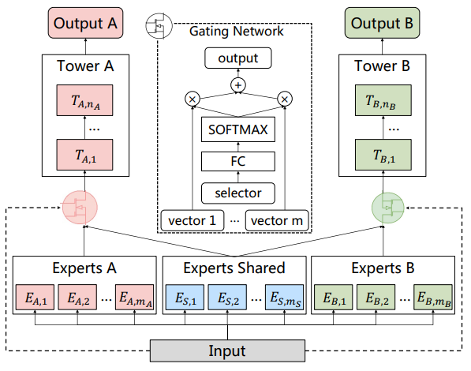
Solving Method – CGC
1. Summary
<Customized Gate Control>
<Customized Gate Control(CGC) Model>
Bottom : Shared & Specific expert modules
Gate : Fuse representation of specific experts and shared experts dynamically
Tower : Absorb knowledge from shared and specific expert through gate
CGC achieves more flexible balance between tasks and better deals with task conflicts and sample-dependent correlation
Notes:
따라서 PLE에서는 크게 3단계로 나눠 문제를 해결합니다.
첫번쨰로 Customized Gate control로, 앞으로 CGC로 부르겠습니다.
CGC는 크게 Bottom / Gate / Tower으로 구성되어 있습니다.
파란색 영역인 Bottom은 각각 Specific Experts 와 Task 간의 공통된 패턴 등을 담당하는 shared Expert 로 구성되어 있습니다.
이때 Expert는 다수의 sub-network로 구성된 하나의 모듈로, 주어진 input에 대해 학습되는 모델을 지칭합니다.
이후 초록색인 Gate를 통해서 각각의 Specific expert와 Shared expert를 dynamic 하게 조합합니다.
마지막으로 Tower에서 Gate를 통해 Specific expert 와 Shared expert 의 정보를 받아 각 task-specific 하게 결과물을 만들어냅니다.
이를 통해 CGC는 Task 간의 균형을 조율하며, Task conflict 및 sample-dependent correlation을 잘 다루게 됩니다.
Therefore, PLE solves the problem by dividing it into three main steps.
First, Customized Gate Control. I'll call it CGC.
The CGC is largely composed of Bottom/Gate/Tower.
The bottom, which is a blue area, consists of shared experts, which are responsible for common patterns between Specific Experts and Tasks, respectively.
Expert is a module that consists of a number of sub-networks and refers to a model that is learned for a given input.
Afterwards, each specific expert and shared expert are dynamically combined through gate in Green.
Finally, the tower receives the information of the specific expert and the shared expert through the gate and produces the results which is related to each task-specific.
This allows the CGC to balance tasks and to handle Task conflict and sample-dependent correlation.

Slide 10
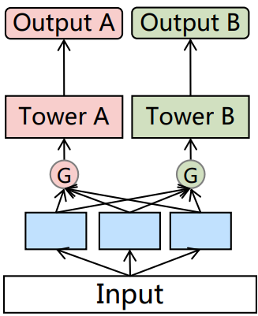
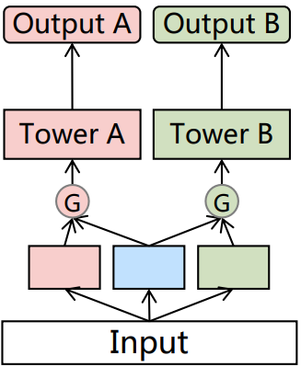
Solving Method – CGC
1. Summary
<MMOE vs CGC>
<MMOE Model>
<CGC Model>
There are two differences
1. Routing
MMOE connect all of experts
CGC connect each specific expert and shared expert
2. Bottom ingredient
MMOE only use task-specific expert
CGC use task-shared / task-specific experts
Specific expert 1
Specific expert 2
Specific expert 3
Specific expert 1
Shared expert
Specific expert 2
It looks like MMOE’s routing strategy is generalization version of CGC.
But truth is not. It’ll be proved later
Notes:
이때 MMOE와 CGC의 차이점에 대해 짚고 넘어가겠습니다.
차이점은 2가지로, 연결 방식(Routing) 과 Bottom Ingredient 입니다.
MMOE는 모든 Expert의 관계를 고려하나, CGC는 각각의 Specific Expert 와 Shared expert 만 고려합니다.
또한 MMOE에서는 Bottom에서 Specific Expert을 고려하나, CGC는 추가적으로 Shared Expert를 고려합니다.
이때, MMOE’s routing 방식이 CGC의 Routing 방식의 일반화한 것 처럼 보이나, 결과는 그렇지 않습니다.
이 부분은 뒤에서 다시 다루겠습니다.
Let's talk about the difference between MMOE and CGC.
There are two differences: Routing Strategy and Bottom Ingredients.
The MMOE considers the relationship of all experts, but the CGC considers only each Specific Expert and Shared Expert.
MMOE also considers the Specific Expert in Bottom, but CGC additionally considers the Shared Expert.
At this time, the MMOE's routing strategy seems to be a generalization of the CGC's routing strategy, but the result is not.
I'll talk about this later.

Slide 11
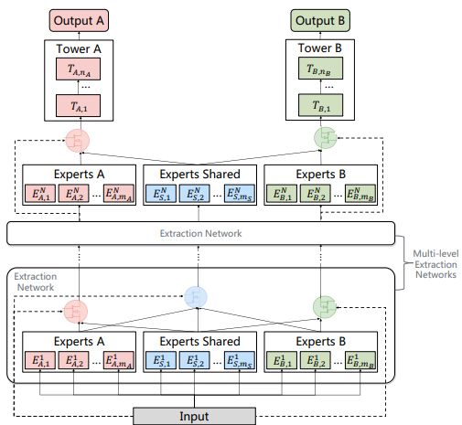
Solving Method – PLE
1. Summary
<Progressive Layered Extraction Model>
<Progressive Layered Extraction>
Hierarchy structure of information
- Extract higher-level shared information
- Gating network in higher-level take the fusion results of gates in lower-level
2. Progressive separation routing
- Remove connection with other task-specific
- Consider high-level shared semantic
representation gradually
PLE shape out deeper semantic representations gradually with dividing whether the intermediate representations is shared or task-specific
Notes:
2번째로 Progressive Layered Extraction을 활용합니다.
이후 PLE로 지칭하겠습니다.
PLE를 통해서 보다 고차원의 Shared information 을 추출합니다.
그리고 Gate를 통해서 저차원의 Information과 고차원의 information 을 Dynamic 하게 합칩니다.
이후 각 Task-specific 끼리의 연결을 제거하여, 고차원의 Semantic representation 이 점차 반영될 수 있도록 Network를 구성합니다.
Second, it utilize Progressive Layered Extraction.
I will refer to it as a PLE.
PLE extract higher-order shared information
And model dynamically combine low-dimensional and high-dimensional information through Gate.
The network is then configured to remove the connection between each task-specific, so that higher-dimensional semantic presentation is gradually reflected.

Slide 12
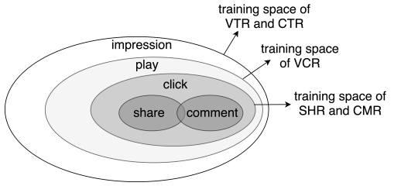
Solving Method – Joint Loss optimization
1. Summary
<Joint Loss Optimization for MTL>
1. Joint Representation
- Solve problem of heterogeneous samples space
ex) Due to sequential users action, share & comment
action are considered as heterogeneous
- Consider the union of sample space to train jointly
2. Introducing dynamic weight
Performance of MTL is sensitive to weight
Consider of weight tasks fluctuated with time
<Training Space of Different tasks>
By applying Joint Representation and dynamic weight, solve several issue in making joint optimization of MTL in practice
Notes:
마지막으로 Joint Loss optimization을 도입합니다.
동일한 샘플로 고려해줘야 하나, 유저의 연속적인 행동으로 인해 서로 다른 샘플로 고려되는 경우가 있습니다.
따라서 이런 경우 샘플 공간을 합쳐줘 함께 학습할 수 있도록 합니다.
또한 MTL의 성능이 가중치에 민감한 점을 고려하여,
가중치가 시간에 따라 변화할 수 있도록 설정합니다.
Finally, we introduce Joint Loss Optimization.
Some samples should be considered as the same, but it may be considered as a different sample due to the user's continuous behavior.
Therefore, in this case, combine the sample spaces so that they can learn together.
In addition, considering that MTL's performance is sensitive to weights,
Sets up the weight to change over time.

Slide 13
Experiment
1. Summary
Data
Industrial dataset from Tencent. 46,926 mil users / 2,682 mil video, 0.996 billion samples in Dataset
Public Dataset : Synthetic Data, Census-income Dataset, Ali-CCP Dataset
Baseline model
Single model : Normal, Symmetric, Customized sharing, Cross-stitch, Sluice Network, MMOE
Multitask model : ML-MMOE
Test Case
1) Degree of Correlation between Variables(Strong or Loose)
2) Single-task model on Online A/B test
3) Single / Multi tasks
4) Expert Utilization Analysis between MMOE & PLE
Estimation
Calculate AUC & MSE of each Indicator(main on VCR, VRT) + MTL Gain
* MTL Gain : Quantitively evaluate the benefit of Multi-task learning over the single-task model
Notes:
앞서 설명한 방법들을 기반으로 PLE의 성능을 확인할 것입니다.
Experiment의 세부 사항은 다음과 같습니다.
Based on the methods described above, paper check the performance of the PLE.
Details of the Experiment are as follows:

Slide 14
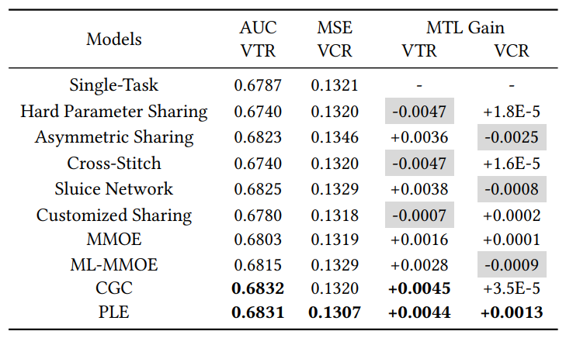
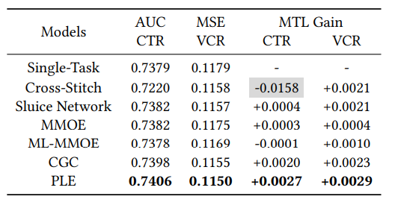
Result
1. Summary
<Strong Correlation between Variable>
<Loose Correlation between Variable>
identify seesaw phenomenon exist
PLE’s performance is really close to SOTA-method or over-performance
Even correlation between variables is loose, PLE overscore SOTA-MTL method
Regardless relation between variable is strong or loose,
PLE overscore for most aspect of test then SOTA-MTL method
Notes:
노란색 영역을 통해 우리는 Strong correlation 상황 속에서 Seesaw phenomenon 이 실제로 있음을 확인할 수 있습니다.
그리고 PLE의 성능이 여러 MTL 방법과 비교했을 때
Seesaw phenomenon 을 해결한다는 점
심지어 seesaw phenomenon이 거의 없는 Loose Correlation 상황에서도 대부분 최고 성능을 내고 있음을
확인할 수 있습니다.
Through the yellow area, we can see that Seesaw phenomenon really exists in the Strong correlation situation.
By Comparing PLE with several MTL methods, we can Check that
PLE solves the Seesaw phenomenon
Even in Loose Correlation situations where there is little seesaw phenomenon, most of cases are performed at SOTA’s achievements

Slide 15
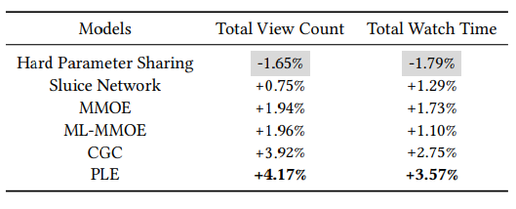
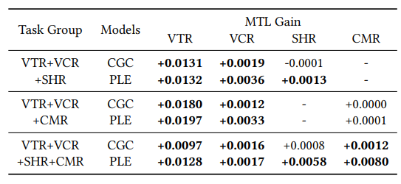
Result
1. Summary
<Performance on Online A/B test>
<MTL gain of CGC & PLE on Multi Tasks>
Shows improvement of MTL models over the single-task model on Online total
view count & watch time
CGC & PLE demonstrate the benefits of promoting task cooperation
PLE outperforms CGC in all cases
PLE delivers the best performance in real-world online applications
And it also proved the positive influence of Multi-task.
Notes:
PLE는 실제 Online A/B test에서도 Total View Count 및 Total watch Time을 각각 4.17%, 3.57% 향상시켜 최고의 결과를 도출했습니다.
또한 Task Group의 조합을 3개, 4개로 늘렸을 때의 모든 경우에서
CGC, PLE는 항상 긍정적인 결과를 가져옴을 확인할 수 있습니다.
PLE also achieved the best results in the actual Online A/B test
by improving Total View Count and Total Watch Time by 4.17% and 3.57%, respectively.
Also, in all cases, when you increase the combination of Task Groups to 3 and 4,
You can see that CGC and PLE always bring positive results.

Slide 16
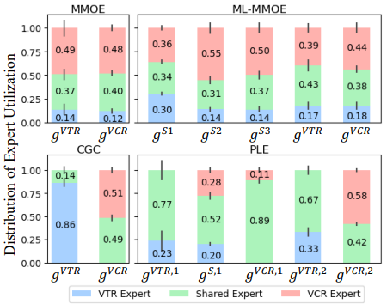
Result
1. Summary
MMOE’s routing is not Generalization of CGC’s
Distribution between MMOE & ML-MMOE is similar
But distribution of CGC& PLE is significantly different.
→ CGC’s structure helps achieve better differentiation & MMOE hard to converge CGC without prior knowledge
Higher-level deeper representation is Valuable
PLE performs better than CGC
Shared expert in PLE have larger influence
→ Progressive separation routing provides a better joint routing and performance. And it means high-level deeper representation(-shared expert) is valuable
<Expert Utilization in Gate-Based Models>
Expert Utilization show that PLE is good model than ML-MMOE & Higher-level deeper representation is Valuable in MTL
Notes:
마지막으로 MMOE, ML-MMOE, CGC, PLE 네 모델의 Expert Utilization을 통해 알 수 있는 점 입니다.
앞서 MMOE의 Routing Strategy는 Bottom의 모든 Ingredient를 고려하여, 일부만 고려하는 CGC의 것과 비교해 일반화된 것처럼 보입니다.
하지만 MMOE와 CGC, 그리고 ML-MMOE와 PLE 관계에서 각 Expert의 사용 비율이 매우 차이나는 것,
그리고 오히려 CGC와 PLE가 MMOE, ML-MMOE 보다 성능이 좋다는 점을 통해
MMOE의 Routing strategy는 CGC의 strategy으로 수렴하지 않으며 Optimal 하지 않다는 것을 알 수 있습니다.
또한 CGC와 PLE의 관계에서,
PLE에서 Shared expert의 비율이 상대적으로 매우 높다는 점,
그리고 PLE의 성능이 CGC보다 좋다는 점을 통해서
Progressive separation 과 high-level deeper representation 이 성능 향상에 도움이 된다는 점을 알 수 있습니다.
Finally, we can find out insights from the Expert Utilization of the four models MMOE, ML-MMOE, CGC, and PLE.
In earlier, I said that MMOE's Routing Strategy seems to be generalized compared to CGC's, which takes into account all Bottom's Ingredients.
However, in the relationship between MMOE and CGC, and ML-MMOE and PLE, the percentage of use of each expert is very different
And through the fact that CGC and PLE perform better than MMOE and ML-MMOE,
It can be seen that the routing strategy of MMOE does not converge to the strategy of CGC and is not optimal.
Also, in the relationship between CGC and PLE,
The proportion of shared experts in PLE is relatively very high
And through the fact that PLE's performance is better than CGC,
We can see that progressive separation and high-level deeper presentation help improve performance.

Slide 17
2. Pros & Cons
Strong point
Weak point
Notes:
다음은 Paper의 장점과 단점입니다.
The following are the Pros & Cons of Paper.

Slide 18
Strong point
2. Pros & Cons
1. Novel Idea(Contribution)
2. Good Motivation
3. Reproducible
4. Convincing Results
Notes:
강점은 다음 4가지 기준에 맞춰 말씀드리겠습니다.
I will tell you strong point based on the following four criteria.

Slide 19
Novel Idea(Contribution)
2. Pros & Cons
1. Specify the problem “Seesaw Phenomenon” and why this happen.
- Improvement of one task often leads to performance degeneration of the other task
- “Seesaw Phenomenon” occurs when tasks are strongly correlated and especially sample dependent
2. Solving “seesaw Phenomenon” & “Negative transfer” and achieve SOTA’s grade
Propose CGC and Information routing strategy
Propose Gating Network in Higher-level extraction Network
3. Show that considering all of relation between tasks not guarantee optimal result
- MMOE’s gate connect all of tasks but, PLE only connect each specific tasks & shared tasks
- PLE overscore MMOE in most case.
- There is significant difference between distribution of PLE and ML-MMOE’s expert Utilization
Notes:
첫째, Novel Idea 관점에서 3가지를 뽑았습니다.
먼저 Seesaw phenomenon을 최초로 정의하고, 왜 이것이 발생하는지를 구체화한 것입니다.
이를 통해서 왜 기존의 방법들과 달리 PLE 방법이 성능을 더욱 향상시킬 수 있는지에 대한 근거를 제시할 수 있었으며,
또한 Seesaw phenomenon 상황이 발생할 수 있는 경우를 미리 대비할 수 있기 때문입니다.
둘째로 Seesaw Phenomenon과 Negative transfer 모두를 함께 해결하며,
대다수의 경우 SOTA 결과를 도출한 점입니다.
그 중에서도 Shared expert 와 Specific expert 를 구별하면서도 적절한 routing Strategy를 적용한다는 개념은
다른 MTL 방법론에도 넓게 적용할 수 있어 보입니다.
마지막으로 MMOE와 CGC의 비교를 통해 설명 드린,
모든 경우를 고려하는 Routing Strategy 보다 특정 연결만을 고려한 모델이 더 나을 수 있음을 확인하였습니다.
이를 통해서 좋은 Network structure을 구성할 이유를 다시 한번 확인할 수 있습니다.
First, I chose three point from the Novel Idea perspective.
First, paper define Seesaw phenomenon and then specify why this is happening.
This provided a basic reason for why the PLE method could further improve performance, unlike previous methods
It's also make to prepare in advance for a possible Seesaw phenomenon situation.
Secondly, PLE solve both of Seesaw Phenomenon and Negative transfer
In most cases, SOTA results are derived.
Among them, the concept of applying appropriate routing strategy for distinguishing between shared and specific experts is
seems to be widely applicable to other MTL methodologies.
Finally, I explained through the comparison between MMOE and CGC
We have confirmed that a model that considers only certain connections can be better than a routing strategy that considers all cases.
This will help you see again why you want to configure a good network structure.

Slide 20
Good to Motivation
2. Pros & Cons
1. Solving common problem of MTL : “Negative transfer” & “Seesaw Phenomenon”
- Since ‘Negative transfer’ frequently occurs in loosely correlated multi tasks.
- On the other side, ‘Seesaw Phenomenon’ frequently occurs in strongly correlated multi tasks, especially sample-dependent situation
→ In most case of MTL, one of problem easily occurs
2. 0.1% improve of AUC/MSE contributes significant improvement to online metric
VCR’s MSE decrease 1.1% & VTR’s AUC increase 0.7%
It result in increase of 4.17% Total view count & 3.57% of Total watch time
in single-task model on Online A/B test
Notes:
PLE는 크게 2부분에서 큰 동기를 얻습니다.
먼저 Negative transfer 과 seesaw Phenomenon은 MTL 에서 흔히 발생하는 문제라는 점입니다.
특히 Negative Transfer과 Seesaw Phenomenon의 발생 조건이 상반되어, 대부분의 MTL 문제에서 둘 중 하나는 쉽게 마주칠 수 있습니다.
따라서 두 문제 모두 해결할 수 있는 PLE는 좋은 방법이라 할 수 있습니다.
또한 각 Task 별로 AUC/MSE를 0.1% 라도 향상시키는 것은 온라인 정책에 있어 큰 개선을 가져옵니다.
Paper에서도 VCR’s MSE를 1.1% 줄이고, VTR’s AUC를 0.7% 증가시켰습니다.
이는 추후에 Total view count 4.17% 증가, Total watch time에 3.57% 증가라는 큰 개선을 가져왔습니다.
The PLE is largely motivated by two parts.
First, Negative transfer and seesaw Phenomenon are common problems in MTL.
In particular, the occurrence conditions of Negative Transfer and Seesaw Phenomenon are contradictory, so one of them can be easily encountered in most MTL problems.
And PLE is a good way to solve both problems.
In addition, improving the AUC/MSE by even 0.1% for each task will lead to significant improvements in online metric.
Paper also reduced VCR's MSE by 1.1% and increased VTR's AUC by 0.7%.
This led to a significant improvement in the Online A/B test: a 4.17% increase in total view count and a 3.57% increase in total watch time.

Slide 21
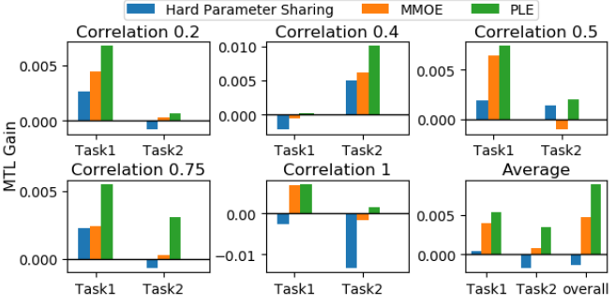
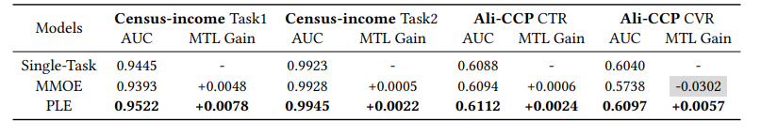
Reproducible
2. Pros & Cons
The PLE method is also effective in Public Data.
- 1.4 mil samples of Synthetic Data are used
- It proved that PLE consistently performs best
for both tasks across different correlations
and achieves 82.7% increase in MTL gain
over MMOE on average
- PLE overscore MMOE in public data of Census-income Dataset and Ali-CCP Dataset
<MTL gain on Synthetic Data>
<Experiment Results on Census-income and Ali-CCP Dataset>
Notes:
PLE은 Reproducible 관점에서도 강점을 가집니다.
1.4 mil Synthetic Data를 사용하여 검증했을 때, 매 순간 MMOE보다 좋은 성과를 가져왔습니다.
또한 Census-income Dataset 및 Ali-CCP Dataset과 같이 공공 데이터에서도 MMOE 보다 좋은 결과를 도출했습니다.
PLE also has strength in terms of reproducible.
When validated with 1.4 mil Synthetic Data, every moment it performed better than MMOE.
Public data, such as Census-income Dataset and Ali-CCP Dataset, also yielded better results than MMOE.

Slide 22

Convincing Results
2. Pros & Cons
1. The PLE method ensured the best performance in most cases with large data
- Using 1 billion samples of Tencent Video recommendation dataset
It showed that 'seesaw phenomenon' exists, and proved that PLE can solve this problem.
Regardless of the correlation degree between tasks, it brought the best performance.
Even increase Total view count and Total Watch Time by 4.17% and 3.57% respectively in the online A/B test.
<Strong Correlation between Variable>
<Loose Correlation between Variable>
<Performance on Online A/B test>
Notes:
Tencent Video의 1 bil의 데이터를 활용하여 PLE의 성능이 특정 소수 상황에 국한된 것이 아님을 보였습니다.
또한 지표 상으로도 Strong Correlation Between Variable 상황에서 Seesaw Phenomenon을 관찰할 수 있으며,
PLE 성능이 Online A/B test 에서도 유의미한 결과를 도출한 점으로 보아
PLE의 성능은 충분히 납득 할 수 있습니다.
Using 1bil of data from Tencent Video, paper demonstrate that the performance of PLE is not limited to certain minority situations.
Also in the aspect of metric, you can observe Seesaw Phenomenon in Strong Correlation situations
Considering that the PLE performance resulted in significant results in the online A/B test,
The performance of the PLE is easily convinced.

Slide 23
Weak point
2. Pros & Cons
1. Additional considerations arising from the introduction of shared experts
1) Calculation volume increase due to updating value
2) Calculation volume increase due to parameter increase
3) Selection problem about appropriate shared expert
2. Lack of explanation
1) Does really 0.1% increase of AUC / MSE statistically meaningful?
2) Why use different metric(AUC/MSE) in figure 3?
Notes:
반면 이 Paper는 크게 2가지 측면에서 Weak point를 가지고 있다 생각합니다.
첫번째는 Shared experts 도입에 따른 추가적인 문제 및 고려할 점이 생긴다는 것이며,
두번째는 일부 서술에 대해서 설명이 부족한 점입니다. .
On the other hand, I think this paper has a Weak point in two main aspects.
The first is the additional considerations arising from the introduction of shared experts
The second is the lack of explanation for some of the descriptions.

Slide 24
Weak point
2. Pros & Cons
1. Additional considerations arising from the introduction of shared experts
1) Calculation volume increase due to updating value
- Parameters of Shared experts are affected by all tasks
while task-specific expert’s are only affected by the corresponding specific task
2) Calculation volume increase proportionally with the number of tasks
- Size of the network parameters grows proportionally with respect to the total number of tasks
- When there are n independent tasks, the number of cases of shared experts become very large.
Even if shared experts only consider relationship between the two tasks,
the number of shared experts required is n(n-1)/2.
3) Selection problem about appropriate shared expert
- Human resource is needed to select appropriate shared experts
Notes:
PLE에서는 Task-specific / Task-shared 개념을 구분하기 위해 Shared expert를 추가로 도입합니다.
이때, Shared expert가 서로 다른 task을 연결하기 위해 Concatenation, sum-pooling, Average-pooling 등의 Common fusion operation을 사용했기 때문에
Shared expert 의 Parameter 는 어떠한 task의 Parameter이 갱신될 때마다 같이 갱신되어야 합니다.
이는 계산 량의 증가를 의미합니다.
두번째로 다수의 Task를 고려할 경우 필요로 하는 계산 량이 급격히 증가합니다.
- MMOE 구조에서도 Task의 개수에 비례하여 필요로 하는 Parameter의 개수가 증가합니다.
- 더불어 PLE에선 각 Task 간의 관계를 고려하기 위해 추가로 Shared expert 를 도입합니다.
이때 각 task 2개 쌍에 대한 관계만 고려한다고 해도 n(n-1)/2 개의 Module을 필요로 하게 됩니다.
마지막으로 적절한 Shared expert를 선택하는 문제가 남아있습니다.
앞서 이야기했듯 단 2개의 Task 사이의 관계만 고려해도 계산 량이 대폭 증가합니다.
그렇다고 모든 Task를 포괄하는 Shared expert를 만들면 고려하는 영역이 좁아지게 됩니다.
결국 사람이 개입하여 Heuristic 하게 모델을 최적화해야 합니다.
PLE introduces additional Shared experts to distinguish Task-specific / Task-shared concepts.
At this time, the Shared expert used common fusion operations such as concatenation, sum-pooling, and average-pooling to connect different tasks
The parameters of the shared expert must be updated together whenever the parameters of any task are updated.
This means an increase in the amount of computation.
Second, when considering a large number of tasks, the amount of computation required increases dramatically.
- The MMOE structure increases the number of parameters required in proportion to the number of Tasks.
- In addition, PLE introduces an additional Shared expert to consider the relationship between each Task.
At this point, even if you consider only the relationship for each pair of tasks, you will need n(n-1)/2 shared experts.
Finally, the problem of selecting the appropriate shared expert remains.
As mentioned earlier, considering the relationship between the two tasks increases the computation significantly.
However, creating a shared expert that covers all tasks will narrow your consideration.
Eventually, we should choose vague point that balance between calculation and expressiveness heuristically.

Slide 25
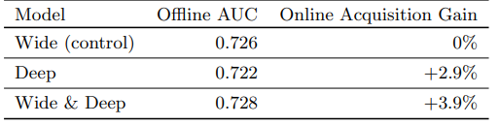
Weak point
2. Pros & Cons
2. Lack of explanation
1) Does really 0.1% increase of AUC / MSE statistically meaningful?
- Paper only mention “It is worth noting that 0.1% increase of AUC or MSE contributes significant improvement to online metrics in our system, which is also mentioned in [4, 6, 14].”
- [14] : “This is a significant improvement for industrial applications where 0.1% AUC gain is remarkable.”
- [6] : use as a reason of [4] such as,
“Wide & Deep improves AUC by 0.275% (offline) and the improvement of online CTR is 3.9%.”
- But when check [4] Cheng et al,
[6] only describes the transition from
the base model(Wide) to the Wide & Deep model,
but does not explain the case of the Deep model
in which the AUC has decreased but the
Online Acquisition Gain has increased.
2) Why use different metric(AUC/MSE) in figure 3?
<Offline & Online metrics of different models>
* Figure from [4] Cheng et al
Notes:
또한 Paper 속 일부 서술에서 설명이 부족한 부분이 있었습니다.
Seesaw Phenomenon을 설명하기 위해 Figure 3을 설명하면서,
“It is worth noting that 0.1% increase of AUC or MSE contributes significant improvement to online metrics in out system, which is also mentioned in [4,6,14]” 라고 서술합니다.
그리고 이를 뒷받침한 근거를 추가로 제시하지 않습니다.
이에 인용된 논문 3개를 확인해봤으나,
[14] 또한 한 문장으로 표현할 뿐이며
[6]에선 4번째 논문에서 AUC의 0.275%의 향상이 online CTR의 3.9%를 연관된 것 처럼 서술합니다.
하지만 [4]를 확인해보면 Wide와 Wide & Deep 만 고려한 것이며,
오히려 AUC는 떨어지지만 Online Acquisition Gain이 2.9% 상승하는 경우는 다루지 않고 있습니다.
즉, 어떠한 뒷받침하는 근거 없이 저자가 직관적으로 0.1%의 상승이 유의미하다 주장하고 있음을 알 수 있습니다.
그 외로 Figure 3에서 왜 서로 다른 Metric인 AUC와 MSE로 Seesaw phenomenon을 설명하는지에 대한 근거를 제시하지 않습니다.
There was also a lack of explanation in some of the descriptions in Paper.
Explaining Figure 3 to illustrate Seesaw Phenomenon,
"It is worth noting that 0.1% increase of AUC or MSE attributes signature improvement to online metrics in out system, which is so mentioned in [4,6,14]".
And paper don't provide additional evidence to support this.
I checked the three papers cited
[14] just said one sentence,
[6] mention that in fourth paper, a 0.275% improvement in AUC is described as related to 3.9% of online CTRs.
However, if we check [4], only basic model Wide and Wide & Deep are considered
On the contrary, it does not deal with cases where the AUC falls but the Online Acquisition Gain rises by 2.9%.
In other words, it can be seen that the author intuitively argues that the increase of 0.1% is significant without any supporting evidence.
In Addition, Figure 3 does not provide a basis for why different metrics, AUC and MSE, describe Seesaw phenomenon.

Slide 26
3. Research Idea
Notes:
마지막으로 Research Idea입니다.
Finally, Research Idea.

Slide 27
3. Research Idea
1.Reduce the amount of calculation
1) Introducing Dropout
2) Check applicability of parallel and distributed MTL
3) Dimension reduction about domain of tasks
2. Expand to multi-domain learning
3. Combination of multi view/domain/tasks
4. More deep PLE Model
Notes:
추후 연구 주제로 4가지를 선정하였습니다.
첫번쨰로 PLE의 계산 량 문제를 해결하는 것입니다.
한 예시로 Dropout을 PLE 모델에 적용하고자 합니다.
기존의 PLE가 Task의 개수에 비례하여 고려할 Parameter수가 증가하였는데,
Dropout을 적용하여 한번에 고려하는 Task의 개수를 고정시킨다면 계산을 효율적으로 할 수 있을 뿐더러 모델의 Robustness까지 제공할 수 있겠습니다.
특히 Dropout을 통해 한번에 고려하는 Parameter 개수를 줄인다면,
Parallel and distributed MTL 방법을 적용할 수 있겠습니다.
추가적으로 Parameter 에 Dimension reduction 하는 개념을 차용하여,
Task 간에서도 중요한 Task를 선별 또는 새로운 Task로 합칠 수 있다면 계산 량 감소 개선을 할 수 있겠습니다.
두번째로 MTL의 방식을 Multi-domain 에 적용하는 것입니다.
Multi task의 경우, 동일한 영역에 대해서 서로 다른 Task을 결합하는 방법론입니다.
이를 바꿔 서로 다른 컨텐츠에 대한 VTR’s AUC 측정과 같이,
서로 다른 영역에 대해서 같은 Task를 부여함으로 한번 더 성능 향상을 이끌어 낼 수 있겠습니다.
더 나아간다면 Multi-view, Multi-domain, Multi-task와 같이 Multi learning 방식들을 결합할 수 있다면
더 나은 성능을 이끌어 낼 수 있겠습니다.
마지막으로 PLE 모델을 보다 깊게 구성하는 것입니다.
현재 이해한 바로는 PLE 층을 기반으로 해서 lower-level 과 Higher-level로 모델을 구분했습니다.
이에 대해서 층을 더욱 깊게 하고 다수의 PLE 층을 부여한다면
보다 Higher-level deeper representation을 이끌어 낼 수 있겠습니다.
I think about four Idea for future research.
The first is to solve the computation problem of the PLE.
As an example, I want to apply Dropout to the PLE model.
The number of parameters of PLE are increased in proportion to the number of tasks
By applying Dropout to fix the number of tasks you consider at once, we can not only calculate efficiently but also provide robustness for the model.
Especially if we reduce the number of parameters through Dropout
we can apply the Parallel and distributed MTL method.
Additionally, By using the concept of dimension reduction in tasks,
Such as important tasks can be selected between tasks or combined into new tasks, we can improve the amount of computation reduction.
Secondly, applying MTL's method to Multi-domain.
For Multi tasks, it is a methodology that combines different tasks for the same area.
By changing this, like measuring VTR's AUC for different content,
By giving the same tasks to different areas, we can once again drive performance improvement.
If you could combine multi-learning methods like multi-view, multi-domain, and multi-task,
We can deliver better performance.
Finally, structure more deer hierarchy PLE model
Based on the PLE layer, we have divided the model into lower-level and higher-level.
If you deepen the layer and give multiple layers of PLE,
I expect that model can bring out higher-level deeper presentation.

Slide 28
Q n A
Notes:
그럼 여기 까지가 제 발표였습니다.
질문 있으신 분들은 편히 질문해주시기 바랍니다.
If you have any questions, please feel free to ask.

